Slide 1
Ra
Android version of the boardgame
By Benjamin Sklar

Slide 2
Ra
3-5 player boardgame
Auction based
Players accumulate tiles via auctions and score their tiles at end of each of 3 epochs. Tiles are grouped into various categories.
Game description: http://boardgamegeek.com/boardgame/12/ra
iOS version description: https://videogamegeek.com/videogame/86774/reiner-knizias-ra
Source: https://github.com/brskl/Ra
Video presentation: https://youtu.be/n_CXcqok1U0

Slide 3
Computer versions
iOS version
Desktop version
My Android version
v0.1 – based on class material from Fall Quarter 2016 text based with primary goal to implement game functionality
v0.2 – based on class material from Winter Quarter 2016 primary change is use of graphical elements, other changes include: multiple languages, multiple layouts, etc.
v0.3 – based on class material from Spring Quarter 2017
v1.0 – commercial version to be released to Google Play Store

Slide 4
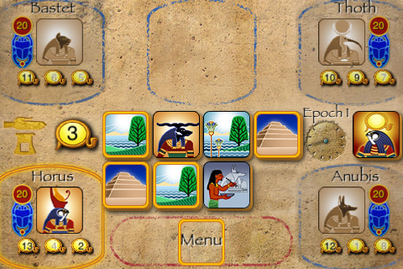
iOS version

Slide 5
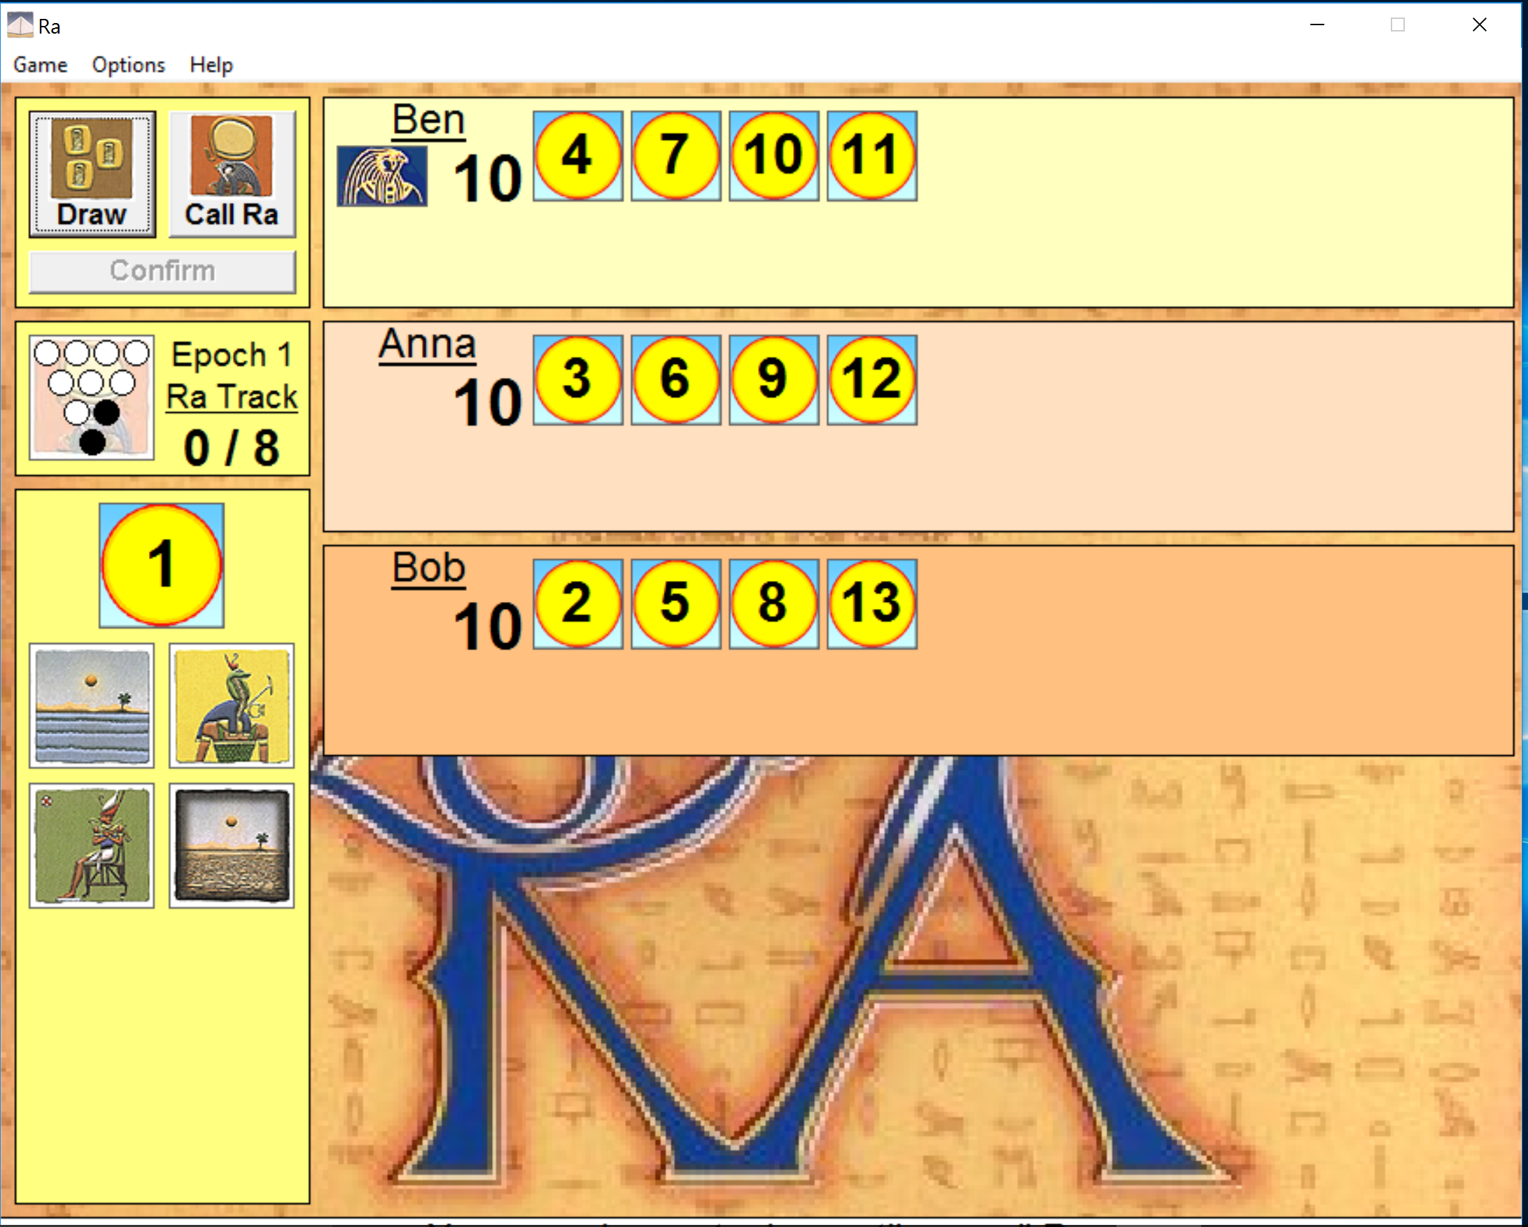
Desktop version
Notes:
Show Ra.exe and do a few moves. Author did it to implement neural network game AI Available at: http://snapper.rooms.cwal.net/games.html

Slide 6
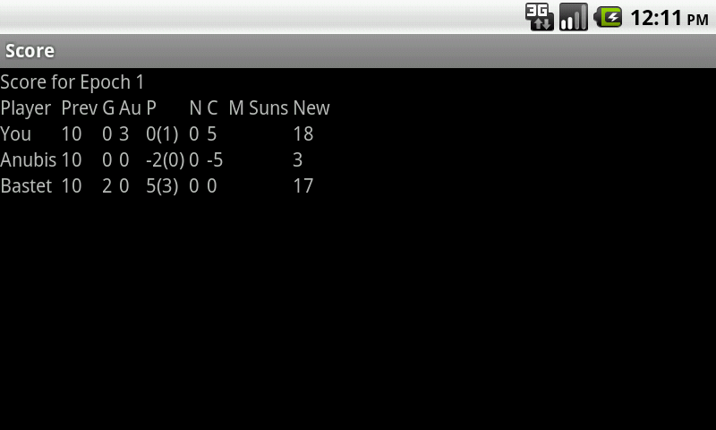
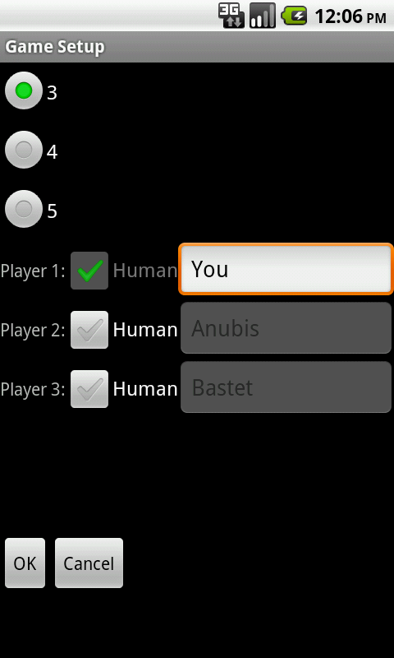
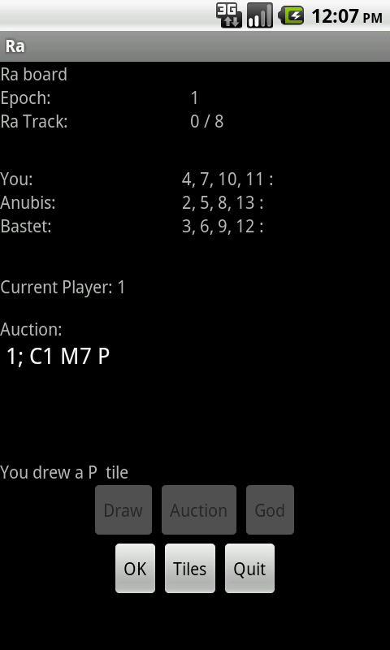
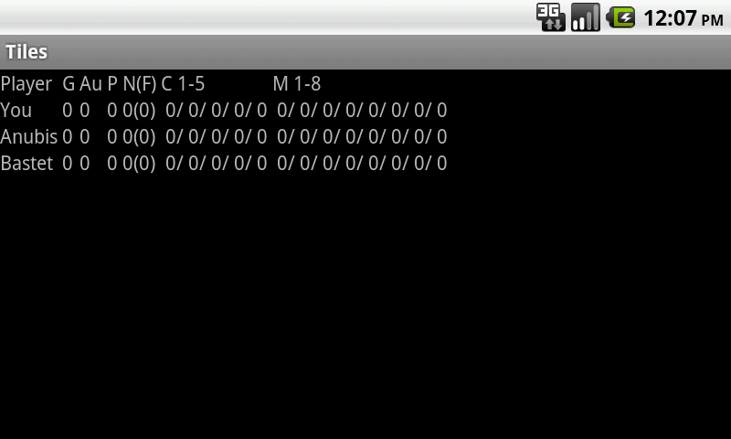
V0.1
Notes:
Textual UI. Primary goal to implement game functionality in working Android app.

Slide 7
V0.2
Main changes
Added graphical elements to GameActivity, ScoreActivity, TilesActivity
Added multiple layouts
Added more strings (plural, localization)
Saving of game-state on GameActivity onStop(), loaded on MainActivity, press ‘Resume’ button.

Slide 8
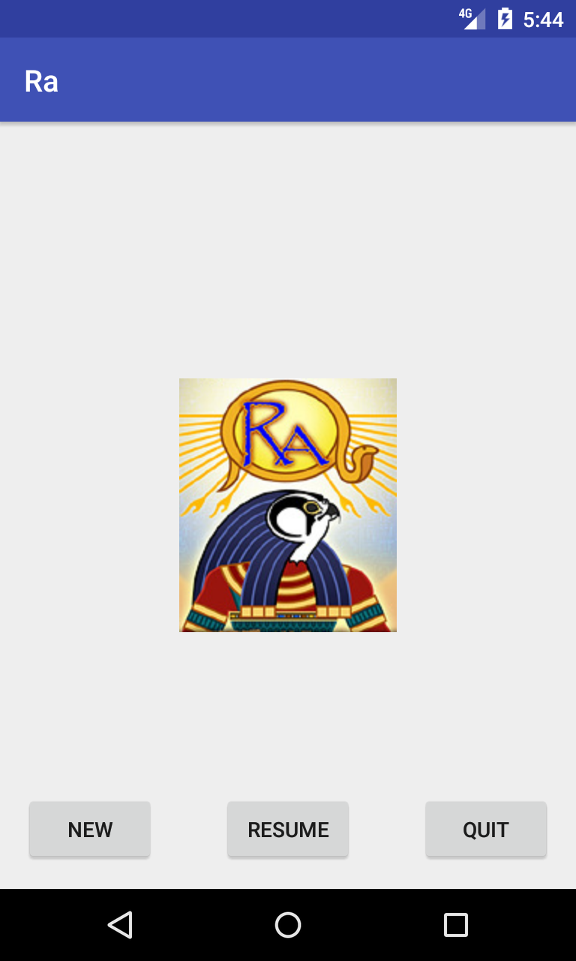
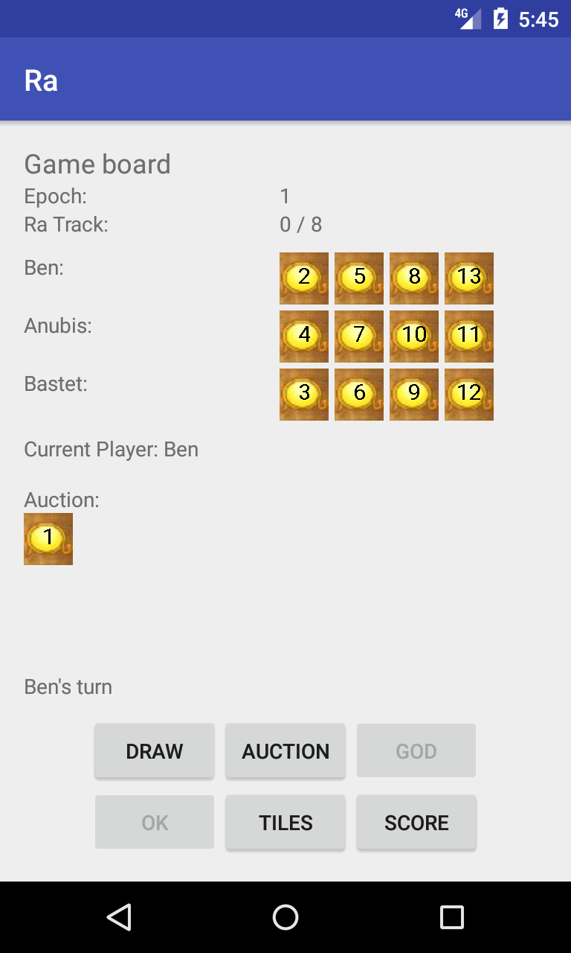
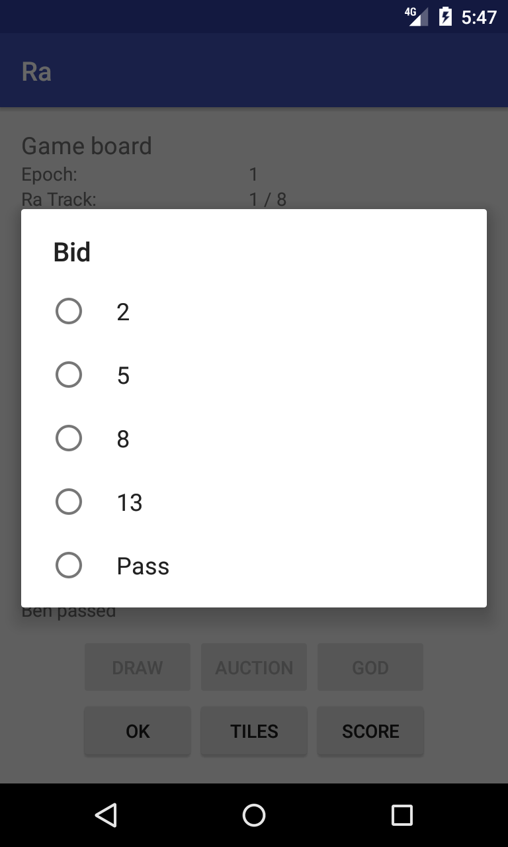
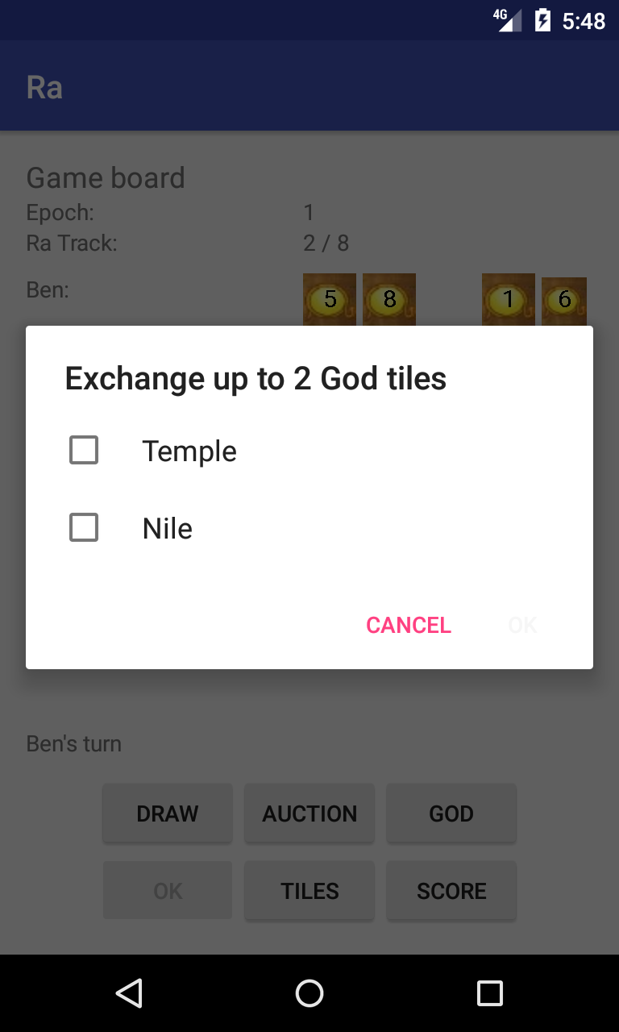
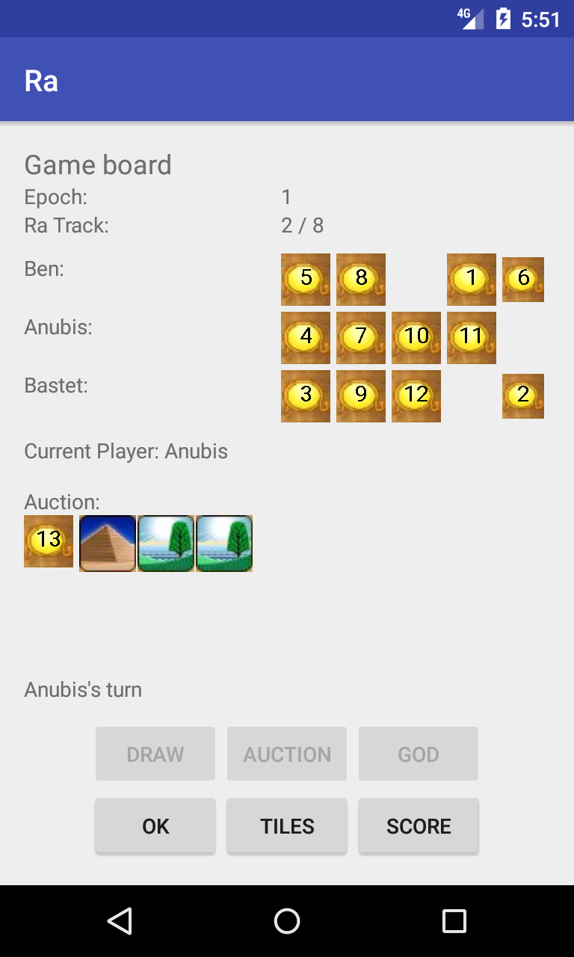
Screenshots

Slide 9
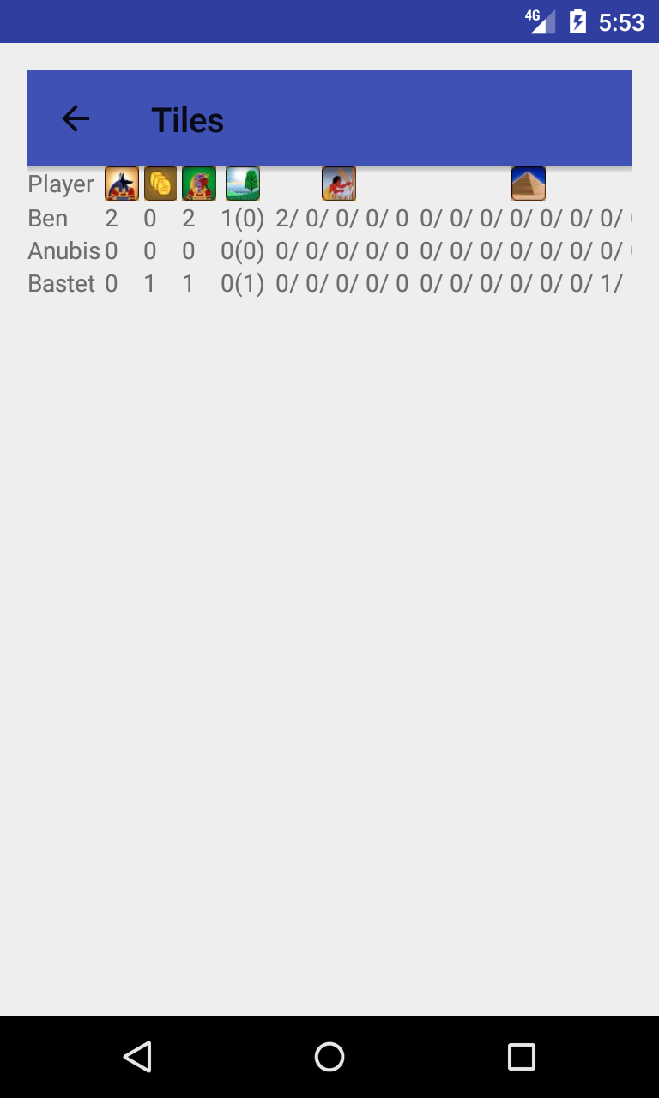
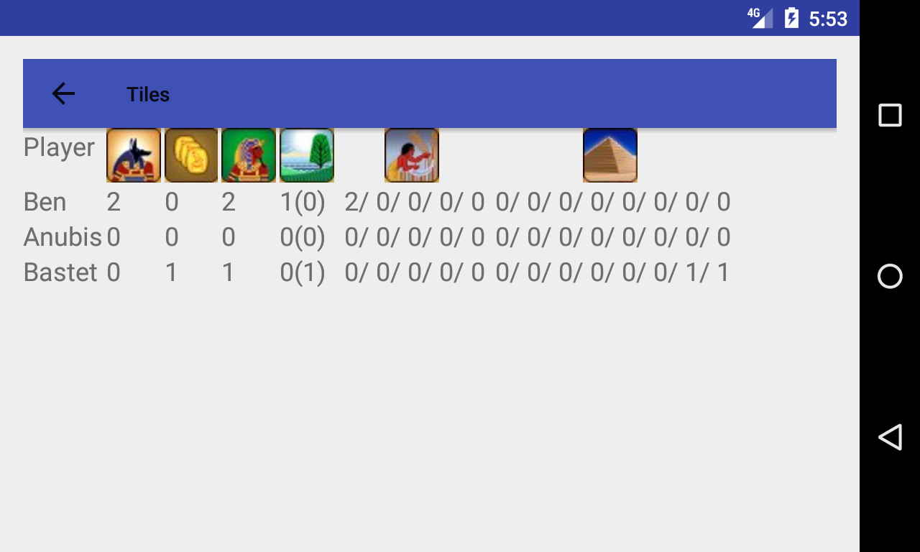
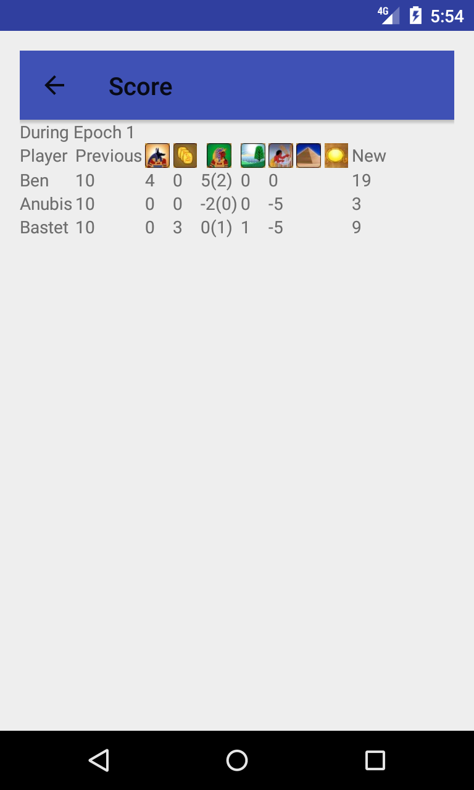
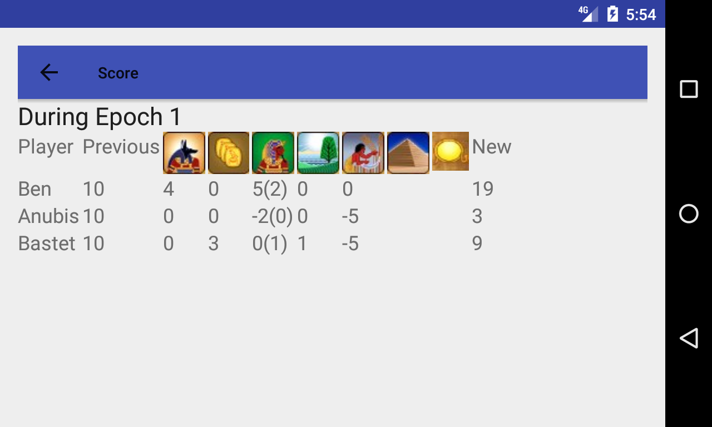
Screenshots

Slide 10
features used
String resources: Plural, multiple languages
New launcher icon w/ multiple resolutions
Animation class used on start-up activity
Multiple Layouts: portrait vs. landscape
‘Up’ navigation
Graphical elements in GameActivity, ScoreActivity, TilesActivity
Saving of game state in internal file
SunImageView subclass of ImageView w/ onDraw to do text numbers over sun-tile graphic

Slide 11
Issues
Still difficult to represent all information on limited screen space of a SmartPhone device. The iOS does a good job on a table and the desktop version also works very well
Uncertain how to communicate between devices for multi-device game. There are various services that provide game matchmaking and game hosting but insufficient time to investigate
Current graphical representation helps with theme but need better artwork at various resolutions and some animation to make UI more friendly and game-like

Slide 12
ToDo
Write reasonable AI players
Improve graphical representations in both static images and animation of ‘game pieces’
Add settings/preferences activity/dialog
Add networking with other devices for multiple human players
Add matchmaking
Move ScoreActivity and TilesActivity into fragments and on laptop devices display as part of GameActivity

Slide 13
Links
Source: https://github.com/brskl/Ra
Presentation video: https://youtu.be/n_CXcqok1U0
This Powerpoint: https://github.com/brskl/Ra/blob/master/doc/Project%20Presentation%20-%20Ra%202017-03.pptx

